Slide 1
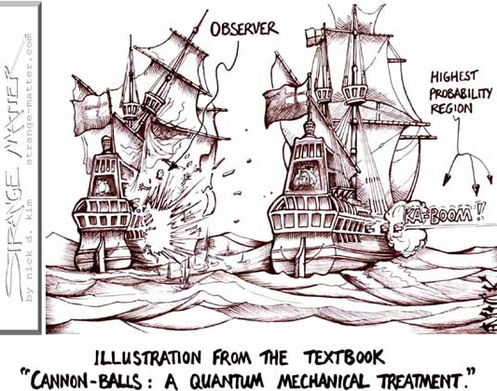

Slide 2
Bead Sliding on Uniformly Rotating Wire in Free Space
Straight wire, rotating about a fixed axis ⊥ wire, with constant angular velocity of rotation ω.
  Time dependent constraint!
Generalized Coords: Plane polar:
⇒ x = r cosθ, y = r sinθ, but θ = ωt, θ = ω = const
Use plane polar results:
T = (½)m[(r)² + (rθ)²] = (½)m[(r)² + (rω)²]
Free space ⇒ V = 0. L = T - V = T
  Lagrange’s Eqtn: (d/dt)[(∂L/∂r)] - (∂L/∂r) = 0
⇒ mr - mrω² = 0 ⇒ r = r₀ e^{ωt}
Bead moves exponentially outward.

Slide 3
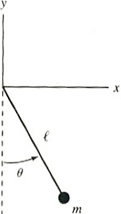
Example (From Marion’s Book)
Use (x,y) coordinate system in figure to find T, V, & L for a simple pendulum (length  , bob mass m), moving in xy plane. Write transformation eqtns from (x,y) system to coordinate θ. Find the eqtn of motion.
T = (½)m[(x)² + (y)²], V = mgy
⇒ L = (½)m[(x)² + (y)²] - mgy
x =  sinθ, y = -  cosθ
x =  θ cosθ, y =  θ sinθ
L = (½)m(θ)² + mg  cosθ
(d/dt)[(∂L/∂θ)] - (∂L/∂θ) = 0
⇒ θ + (g/) sinθ = 0

Slide 4
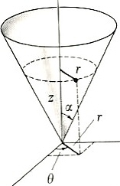
Example (From Marion’s Book)
Particle, mass m, constrained to move on the inside surface of a smooth cone of half angle α (Fig.). Subject to gravity. Determine a set of generalized coordinates & determine the constraints. Find the eqtns of motion.
Worked on blackboard!

Slide 5
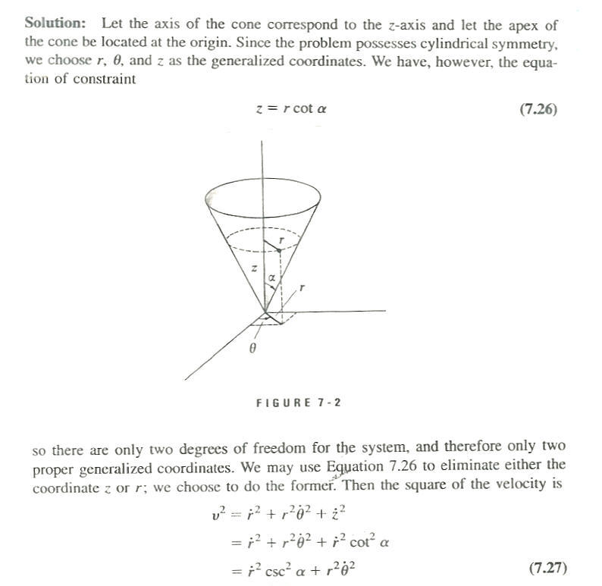
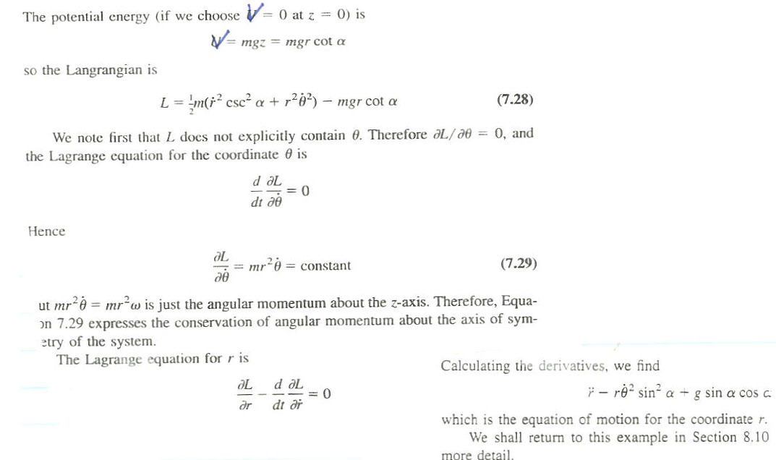
Solution!

Slide 6
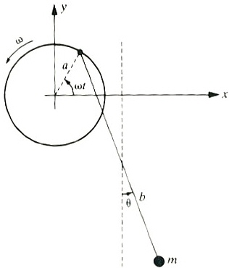
Example (From Marion’s Book)
The point of support of a simple pendulum (length b) moves on massless rim (radius a) rotating with const angular velocity ω. Obtain expressions for the Cartesian components of velocity & acceleration of m. Obtain the angular acceleration for the angle θ shown in the figure.
Worked on
blackboard!

Slide 7
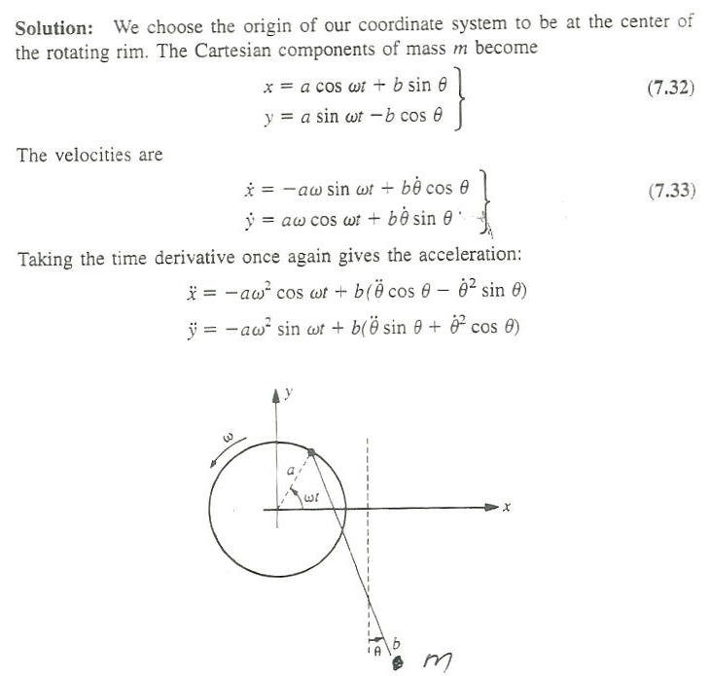
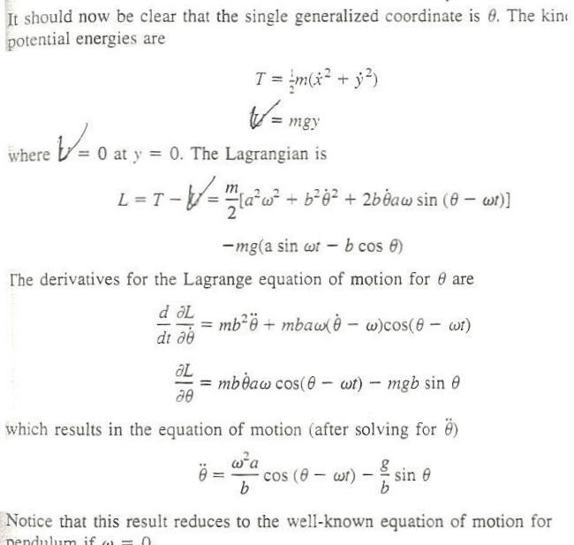
Solution!

Slide 8
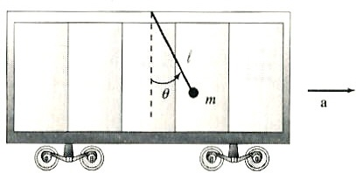
Example (From Marion’s Book)
Find the eqtn of motion for a simple pendulum placed in a railroad car that has a const x-directed acceleration a.
Worked on blackboard!

Slide 9
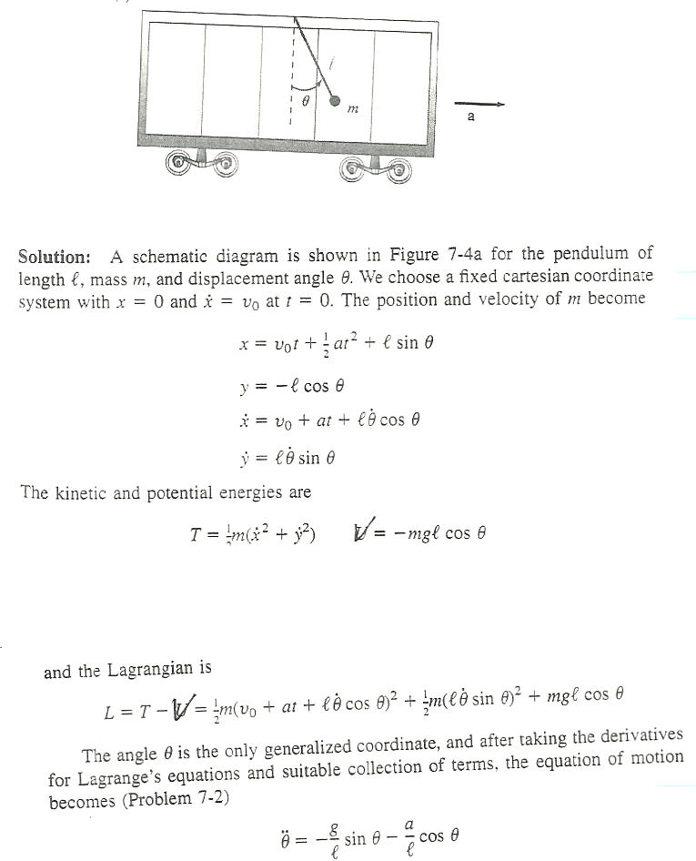
Solution!

Slide 10
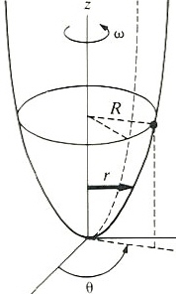
Example (From Marion’s Book)
A bead slides along a smooth wire bent in the shape of a parabola, z = cr² (Fig.) The bead rotates in a circle, radius R, when the wire is rotating about its vertical symmetry axis with angular velocity ω. Find the constant c.
Worked on
blackboard!

Slide 11
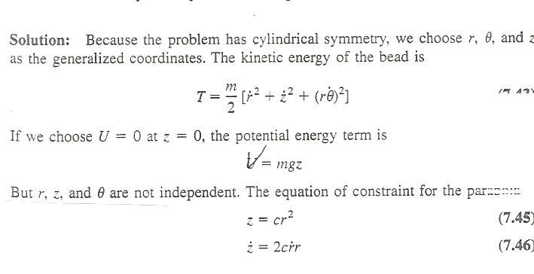
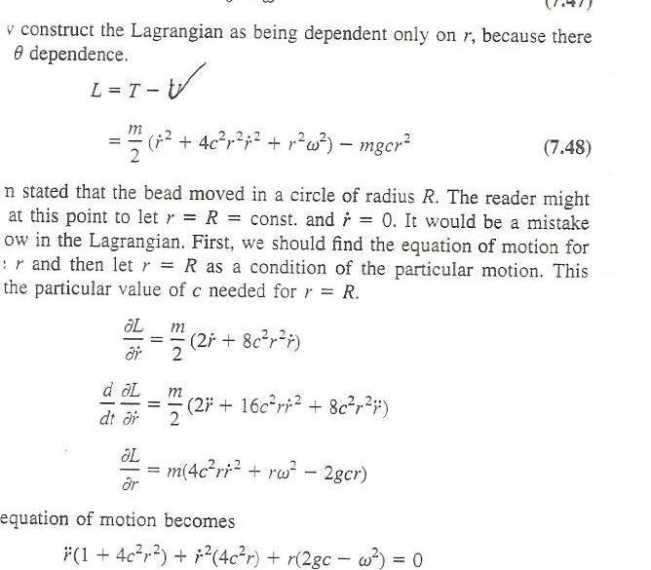
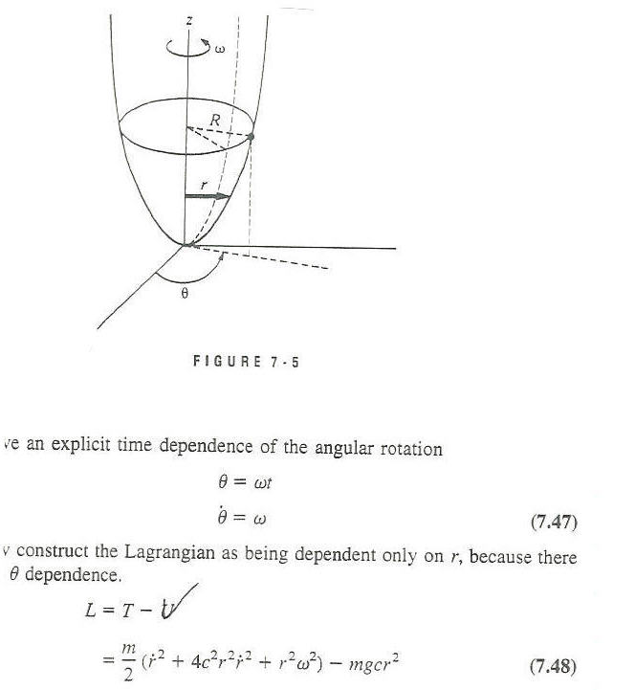
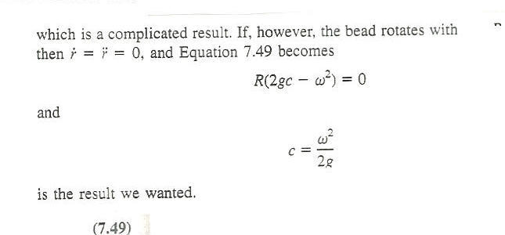
Solution!

Slide 12
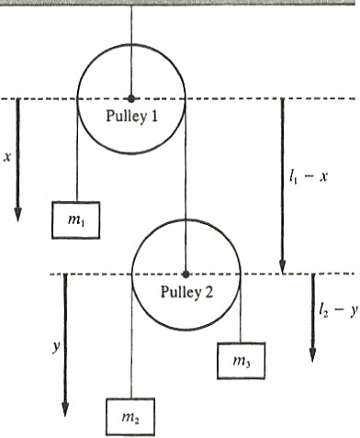
Example (From Marion’s Book)
Consider the double pulley system shown. Use the coordinates indicated & determine the eqtns of motion.
Worked on
blackboard!

Slide 13
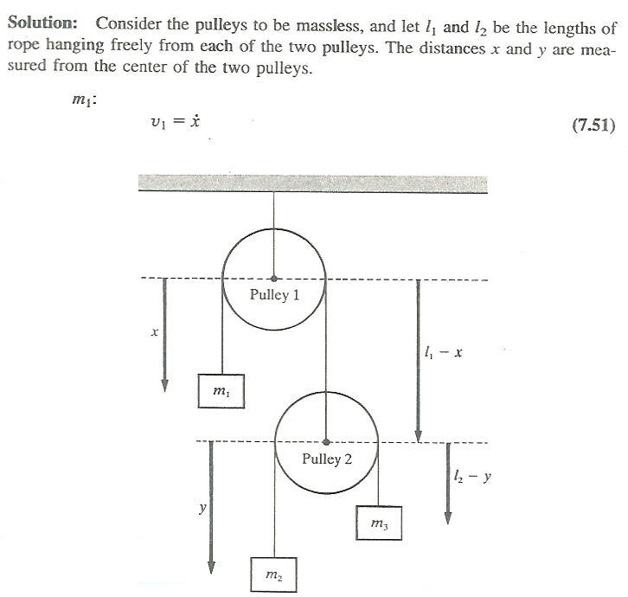
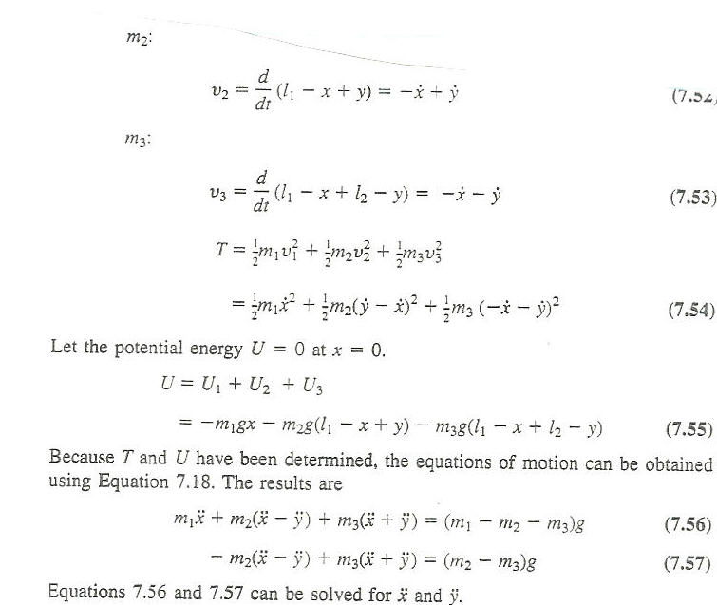
Solution!

